Slide 1
Java Input Output

Slide 2
Java I/O
Java I/O (Input and Output) is used to process the input and produce the output.
Java uses the concept of a stream to make I/O operation fast. The java.io package contains all the classes required for input and output operations.
We can perform file handling in Java by Java I/O API.

Slide 3
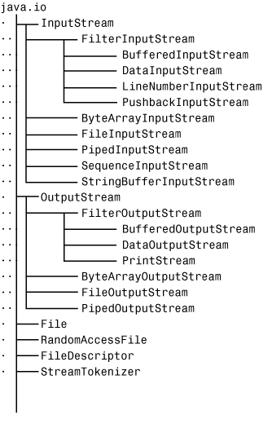
java.io

Slide 4
Stream
A stream is a sequence of data. In Java, a stream is composed of bytes. It's called a stream because it is like a stream of water that continues to flow.
In Java, 3 streams are created for us automatically. All these streams are attached with the console.
1) System.out: standard output stream
2) System.in: standard input stream
3) System.err: standard error stream

Slide 5
Let's see the code to print output and an error message to the console.
System.out.println("simple message");
System.err.println("error message");
Let's see the code to get input from console.
int i=System.in.read();//returns ASCII code of 1st character
System.out.println((char)i);//will print the character

Slide 6
OutputStream vs InputStream
OutputStream
Java application uses an output stream to write data to a destination; it may be a file, an array, peripheral device or socket.
InputStream
Java application uses an input stream to read data from a source; it may be a file, an array, peripheral device or socket.

Slide 7
Let's understand the working of Java OutputStream and InputStream by the figure given below.

Slide 8

File Class
The File class provides the methods for obtaining the properties of a file/directory and for renaming and deleting a file/directory.
An absolute file name (or full name) contains a file name with its complete path and drive letter.
For example, c:\book\Welcome.java
A relative file name is in relation to the current working directory.
The complete directory path for a relative file name is omitted.
For example, Welcome.java

Slide 9
Method and constructor for File class
Constructor:
File(String path_name)
Creates a File object for the specified path name. The path name may be a directory or a file.

Slide 10
Methods of File class
Methods:
boolean isFile()
boolean isDirectory()
boolean isHidden()
boolean exists()
boolean canRead()
boolean canWrite()
String getName()
String getPath()
String getAbsolutePath()
long lastModified()
long length()
boolean delete()
boolean renameTo(File f)
File[] listFiles()

Slide 11
Example
import java.io.*;
public class FileClass
{
public static void main(String[] args) {
File ref1=new File("C:\\Users\\Salil\\Desktop\\Java\\UNIT-5\\Codes\\JavaIO");
System.out.println(ref1.isFile());//It will give false as JavaIO is not a file
System.out.println(ref1.isDirectory());//It will give true as JavaIO is a folder/or directory
File ref2=new File("C:\\Users\\Salil\\Desktop\\Java\\UNIT-5\\Codes\\JavaIO\\abc.txt");
System.out.println(ref2.exists());
System.out.println(ref2.getName());
System.out.println(ref2.getPath());
File ref3=new File("C:\\Users\\Salil\\Desktop\\Java\\UNIT-5\\Codes\\JavaIO\\abc2.txt");
File ref4=new File("C:\\Users\\Salil\\Desktop\\Java\\UNIT-5\\Codes\\JavaIO\\newname.txt");
System.out.println(ref3.isHidden());
System.out.println(ref3.canRead());
System.out.println(ref3.canWrite());
File ref5=new File("abc.txt");
System.out.println(ref5.getPath());
System.out.println(ref5.getAbsolutePath());
System.out.println("Last modified on " + new java.util.Date(ref5.lastModified()));
System.out.println("Length:"+ref5.length());
/*File ref6=new File("abc3.txt");
if(ref6.delete())
System.out.println("File deleted successfully");
else
System.out.println("File does not exists");*/
File x[]=ref1.listFiles();
for(File var:x)
System.out.println(var);
boolean flag = ref5.renameTo(ref4);
if (flag == true) {
System.out.println("File Successfully Renamed");
}
else {
System.out.println("Operation Failed");
}
}
}

Slide 12
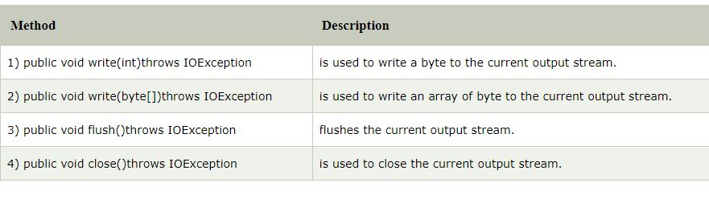
OutputStream class
OutputStream class is an abstract class. It is the superclass of all classes representing an output stream of bytes. An output stream accepts output bytes and sends them to some sink.
Useful methods of OutputStream

Slide 13
OutputStream Hierarchy

Slide 14
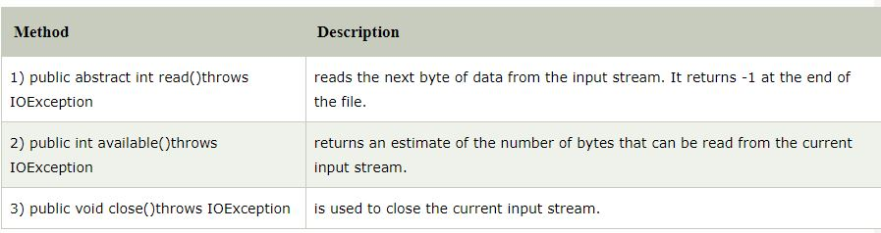
InputStream class
InputStream class is an abstract class. It is the superclass of all classes representing an input stream of bytes.
Useful methods of InputStream

Slide 15
InputStream Hierarchy

Slide 16
Java FileOutputStream Class
Java FileOutputStream is an output stream used for writing data to a file.
If you have to write primitive values into a file, use FileOutputStream class. You can write byte-oriented as well as character-oriented data through FileOutputStream class. But, for character-oriented data, it is preferred to use FileWriter than FileOutputStream.
Let's see the declaration for Java.io.FileOutputStream class:
public class FileOutputStream extends OutputStream

Slide 17
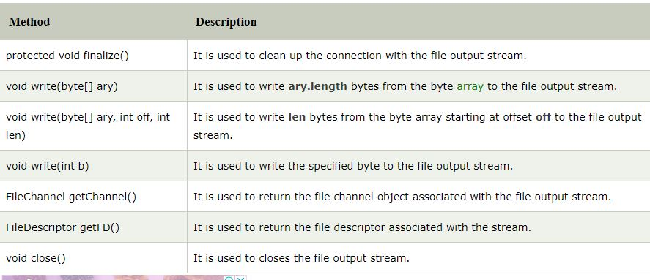
Methods of Java FileOutputStream Class

Slide 18
Java FileOutputStream Example 1: write byte
import java.io.FileOutputStream;
public class Main{
public static void main(String args[]){
try{
FileOutputStream fout=new FileOutputStream("D:\\testout.txt");
fout.write(65);
fout.close();
System.out.println("success...");
}catch(Exception e){System.out.println(e);}
}
}

Slide 19
Java FileOutputStream example 2: write string
import java.io.FileOutputStream;
public class Main {
public static void main(String args[]){
try{
FileOutputStream fout=new FileOutputStream("testout.txt");
String s="Welcome to file handling.";
byte b[]=s.getBytes();//converting string into byte array
fout.write(b);
fout.close();
System.out.println("success...");
}catch(Exception e){System.out.println(e);}
}
}

Slide 20
Appending data through FileOutputStream
import java.io.FileOutputStream;
public class Main{
public static void main(String args[]){
try{
String textToAppend = "Hello !!"; //new line in content
FileOutputStream outputStream = new FileOutputStream("testout.txt", true);//For appending the data here we need to give true in second argument
byte[] strToBytes = textToAppend.getBytes();
outputStream.write(strToBytes);
outputStream.close();
}catch(Exception e){System.out.println(e);}
}
}

Slide 21
Java FileInputStream Class
Java FileInputStream class obtains input bytes from a file. It is used for reading byte-oriented data (streams of raw bytes) such as image data, audio, video etc. You can also read character-stream data. But, for reading streams of characters, it is recommended to use FileReader class.
public class FileInputStream extends InputStream

Slide 22
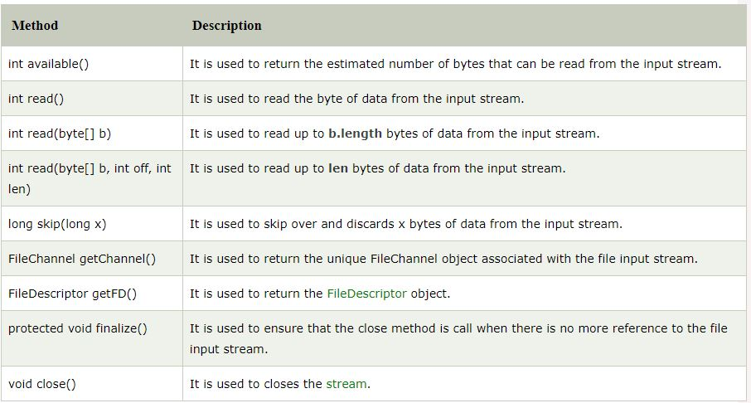
Java FileInputStream class methods

Slide 23
Java FileInputStream example 1: read single character
import java.io.FileInputStream;
public class Main{
public static void main(String args[]){
try{
FileInputStream fin=new FileInputStream("testout.txt");
int i=fin.read();
System.out.print((char)i);
fin.close();
}catch(Exception e){System.out.println(e);}
}
}

Slide 24
Java FileInputStream example 2: read all characters
import java.io.FileInputStream;
public class Main{
public static void main(String args[]){
try{
FileInputStream fin=new FileInputStream("testout.txt");
int i=0;
while((i=fin.read())!=-1){
System.out.print((char)i);
}
fin.close();
}catch(Exception e){System.out.println(e);}
}
}

Slide 25
Practice Programs to do
WAP to copy the data of one file into another file
WAP to read all characters from a file and count total number of vowels from it
WAP to read the content from two files and write their merged content into third file

Slide 26
Reading and writing files
In Java, all files are byte-oriented, and Java provides methods to read and write bytes from and to a file.
Java allows us to wrap a byte-oriented file stream within a character-based object.
We can use Scanner and PrintWriter class to read and write Files.

Slide 27
PrinterWriter Class
This class gives Prints formatted representations of objects to a text-output stream. It implements all of the print methods found in PrintStream.
PrintWriter supports the print( ) and println( ) methods for all types including Object. Thus, we can use these methods in the same way as they have been used with System.out.

Slide 28
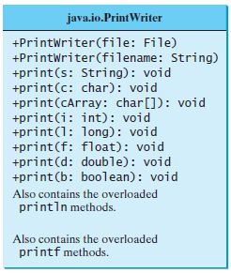
PrintWriter Methods

Slide 29
Example 1
import java.io.*;
public class Main
{
public static void main(String args[])
{
PrintWriter pw = new PrintWriter(System.out, true);
pw.println(“Using PrintWriter Object");
int i = -7;
pw.println(i);
double d = 4.5e-7;
pw.println(d);
}
}

Slide 30
Example 2
import java.io.*;
public class printwriter{
public static void main(String args[]){
try{
PrintWriter pw=new PrintWriter(new File("target.txt"));
pw.print("Hi");
pw.flush();
pw.close();
}catch(Exception e){System.out.println(e);}
}
}

Slide 31
Using Scanner
The java.util.Scanner class is used to read strings and primitive values from the console.
Scanner breaks the input into tokens delimited by whitespace characters.
To read from the keyboard, we create a Scanner as follows:
Scanner s = new Scanner(System.in);
To read from a file, create a Scanner for a file, as follows:
Scanner s = new Scanner(new File(filename));

Slide 32
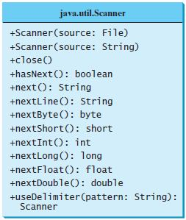
Scanner Methods

Slide 33
Serialization and Deserialization in Java
Serialization in Java is a mechanism of writing the state of an object into a byte-stream.
The reverse operation of serialization is called deserialization where byte-stream is converted into an object. The serialization and deserialization process is platform-independent, it means you can serialize an object in a platform and deserialize in different platform.
For serializing the object, we call the writeObject() method ObjectOutputStream, and for deserialization we call the readObject() method of ObjectInputStream class.

Slide 34
We must have to implement the Serializable interface for serializing the object.
Advantages of Java Serialization
It is mainly used to travel object's state on the network (which is known as marshaling).

Slide 35
java.io.Serializable interface
Serializable is a marker interface (has no data member and method). It is used to "mark" Java classes so that the objects of these classes may get a certain capability. The Cloneable and Remote are also marker interfaces.
It must be implemented by the class whose object you want to persist.
The String class and all the wrapper classes implement the java.io.Serializable interface by default.

Slide 36
import java.io.Serializable;
public class Student implements Serializable
{
int id;
String name;
public Student(int id, String name) {
this.id = id;
this.name = name;
}
}
In the above example, Student class implements Serializable interface. Now its objects can be converted into stream.

Slide 37
ObjectOutputStream class
The ObjectOutputStream class is used to write primitive data types, and Java objects to an OutputStream. Only objects that support the java.io.Serializable interface can be written to streams.
Constructor
public ObjectOutputStream(OutputStream out) throws IOException {}
creates an ObjectOutputStream that writes to the specified OutputStream.

Slide 38
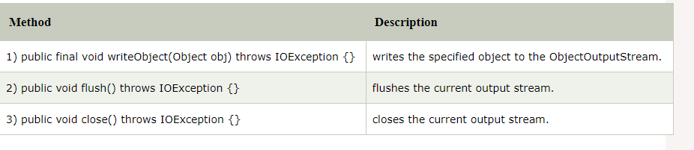
Important Methods

Slide 39
ObjectInputStream class
An ObjectInputStream deserializes objects and primitive data written using an ObjectOutputStream.
Constructor
public ObjectInputStream(InputStream in) throws IOException {}
creates an ObjectInputStream that reads from the specified InputStream.

Slide 40
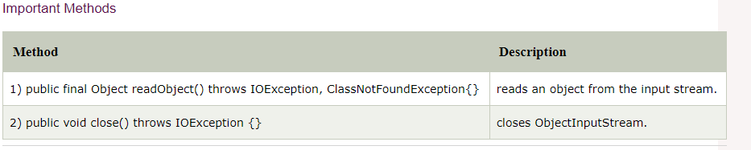
Important Methods

Slide 41
Example ObjectOutputStream
import java.io.*;
class student implements Serializable
{
int roll_no;
String name;
student (int r,String s)
{
roll_no=r;
name=s;
}
}
public class Main
{
public static void main(String[] args) throws Exception
{
FileOutputStream fos = new FileOutputStream("t.txt");
ObjectOutputStream oos = new ObjectOutputStream(fos);
student s= new student(1,"kk");
oos.writeObject(s);
oos.close();
}
}

Slide 42
Example ObjectInputStream
import java.io.*;
class student implements Serializable
{
int roll_no;
String name;
student (int r,String s)
{
roll_no=r;
name=s;
}
}
public class Example
{
public static void main(String[] args) throws Exception
{
FileInputStream fos = new FileInputStream("E:\\t.txt");
ObjectInputStream oos = new ObjectInputStream(fos);
student s=(student)oos.readObject();
System.out.println(s.roll_no+" "+s.name);
oos.close();
}
}

Slide 43
Java Serialization with Inheritance
If a class implements serializable then all its sub classes will also be serializable. Let's see the example given below:
import java.io.Serializable;
class Person implements Serializable{
int id;
String name;
Person(int id, String name) {
this.id = id;
this.name = name;
}
}

Slide 44
class Student extends Person{
String course;
int fee;
public Student(int id, String name, String course, int fee) {
super(id,name);
this.course=course;
this.fee=fee;
}
}
Now you can serialize the Student class object that extends the Person class which is Serializable. Parent class properties are inherited to subclasses so if parent class is Serializable, subclass would also be.

Slide 45
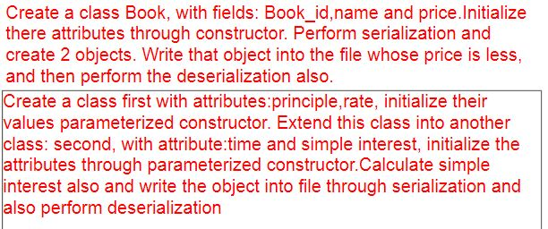
Practice questions

Slide 46
Which of these methods are used to read in from file? a) get() b) read() c) scan() d) readFileInput()
Notes:
b

Slide 47
Which of these values is returned by read() method is end of file (EOF) is encountered? a) 0 b) 1 c) -1 d) Null
Notes:
c

Slide 48
Which of these exception is thrown by close() and read() methods? a) IOException b) FileException c) FileNotFoundException d) FileInputOutputException
Notes:
a

Slide 49
Which of these methods is used to write() into a file? a) put() b) putFile() c) write() d) writeFile()
Notes:
c

Slide 50
What will be the output of the following Java program?
import java.io.*;
class filesinputoutput
{
public static void main(String args[])
{
InputStream obj = new FileInputStream("inputoutput.java");
System.out.print(obj.available());
}
}
Note: inputoutput.java is stored in the disk.
a) true
b) false
c) prints number of bytes in file
d) prints number of characters in the file
Notes:
c

